Slide 1


Project presentation
Magic fight
Group 21
ZHANG XINGYU PENG SHAOZE TIAN YUYANG XU XINDI

Slide 2


Project objectives
Traditional games: Single interaction and low immersion
Objective: All-round interactive gaming experience
Immersive Experience
Voice Control
Gesture Recognition
Virtual Reality

Slide 3
Project scope
Voice data collection and preprocessing – ALL
Flask, Javascript, Google cloud storage bucket
Speech recognition model training – SHAOZE
Tensorflow lite, Python
Embedded machine learning sensing system development – XINDI
C++, Arduino Nano 33 BLE Sense
Bluetooth data transmission development – XINGYU
C#, Unity, Arduino Bluetooth Plugin
Unity game development – XINGYU, YUYANG
C#, Unity, UI

Slide 4
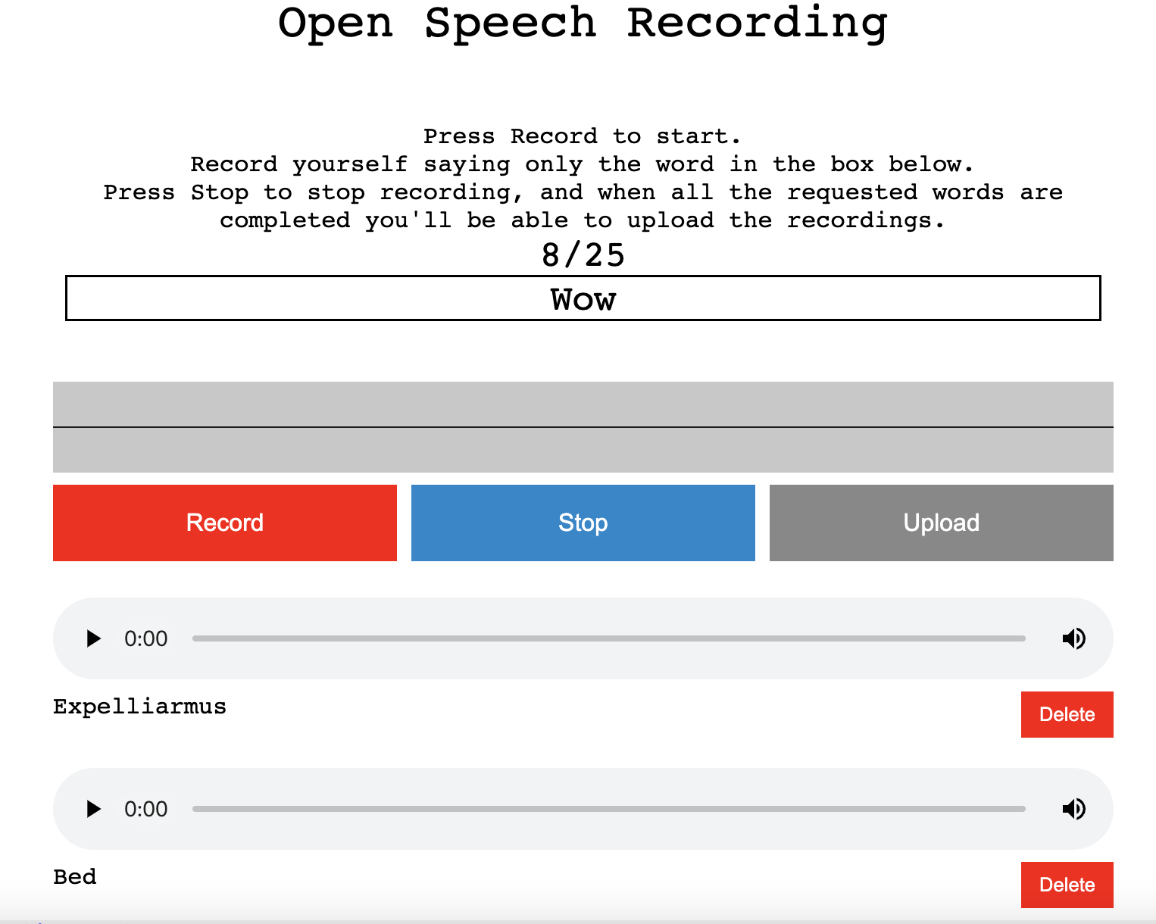
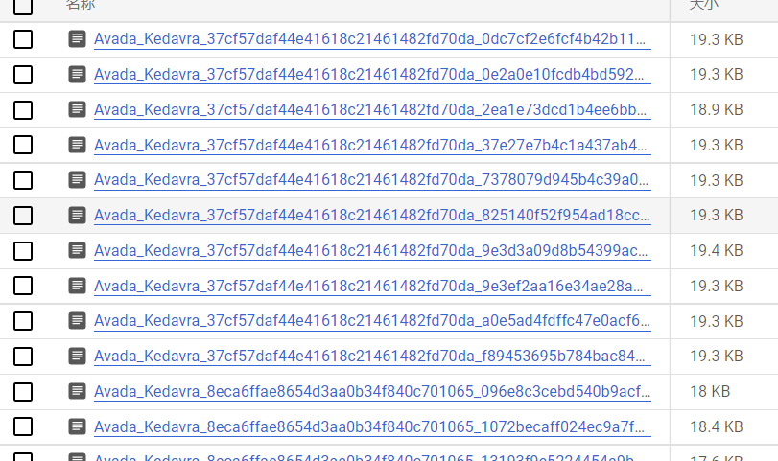
Data required/available
Self-collected audio dataset.
Data preprocessing
Format conversion
Data cleaning
Triming audio files

Slide 5
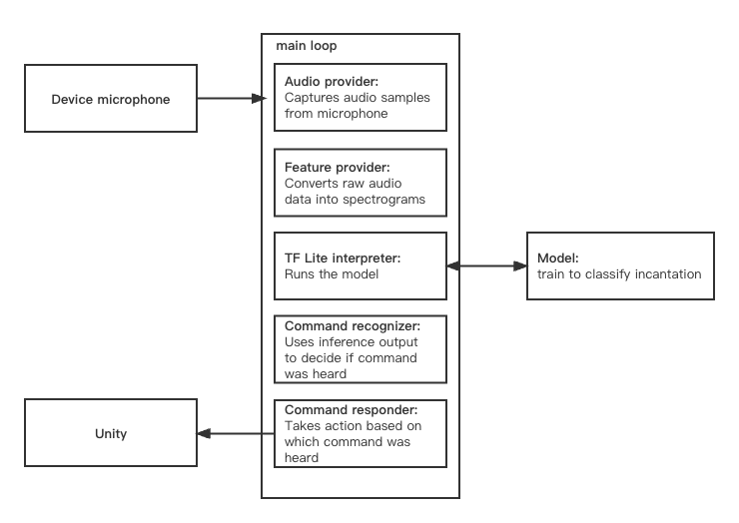
Technical approach

Slide 6
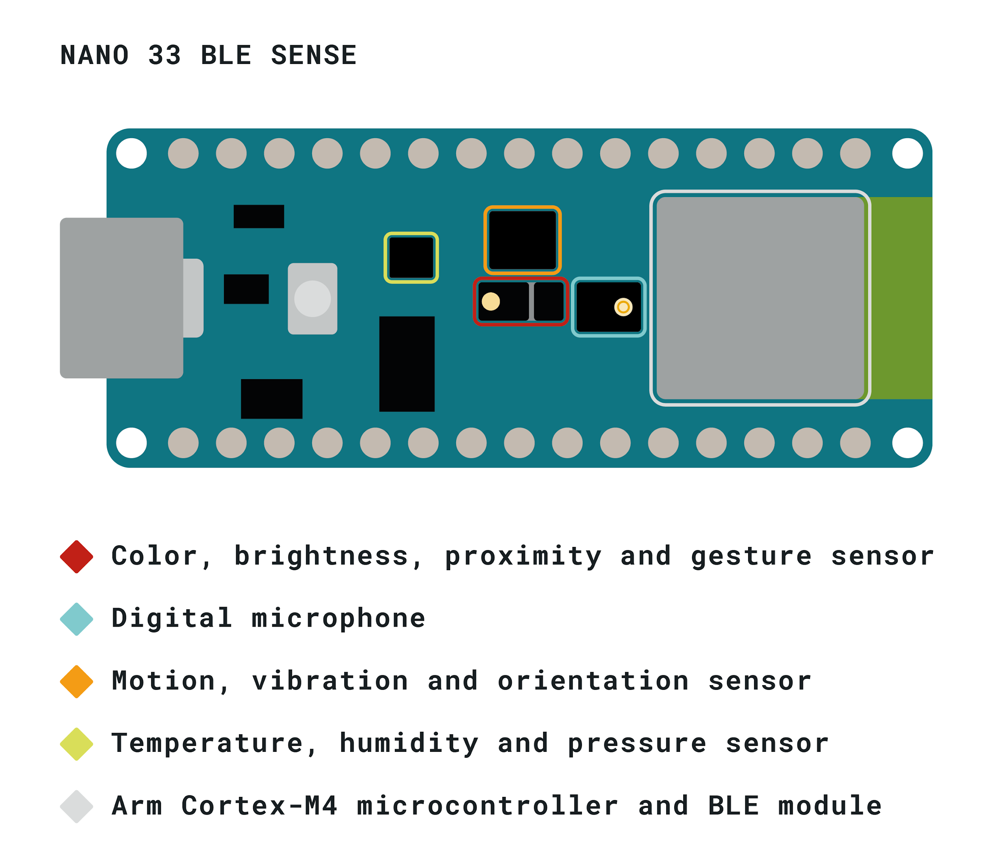
Technical approach

Slide 7
Project Progress
Data collection website:https://magicfight.de.r.appspot.com
Bluetooth data transmission module
Voice model feasibility verification
Unity scene design

Slide 8
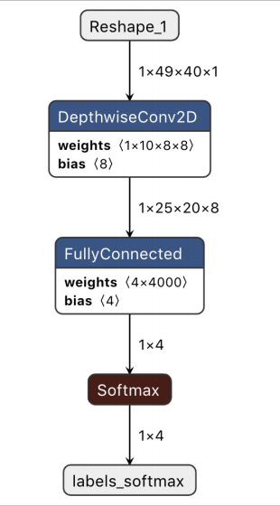
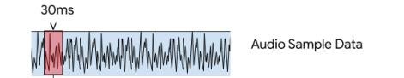
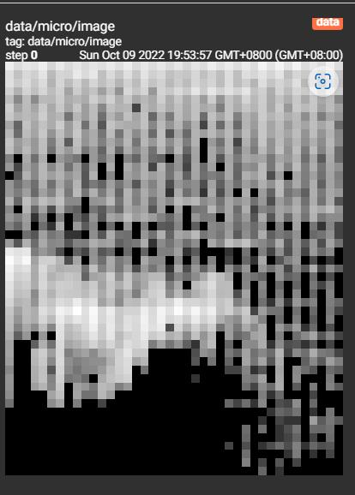

Model Training

Slide 9
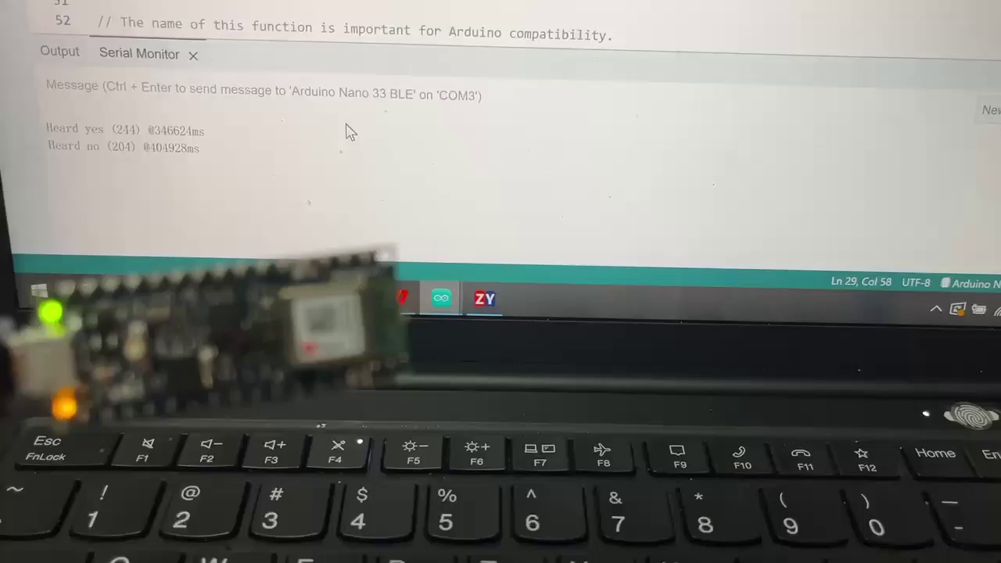
Demo

Slide 10

Unity scene

Slide 11
Thank you !

